Slide 1

Cognizant: Artificial Intelligence
Task 3 – Model Training & Interpretation
Akshay Pandurang Paunikar

Slide 2

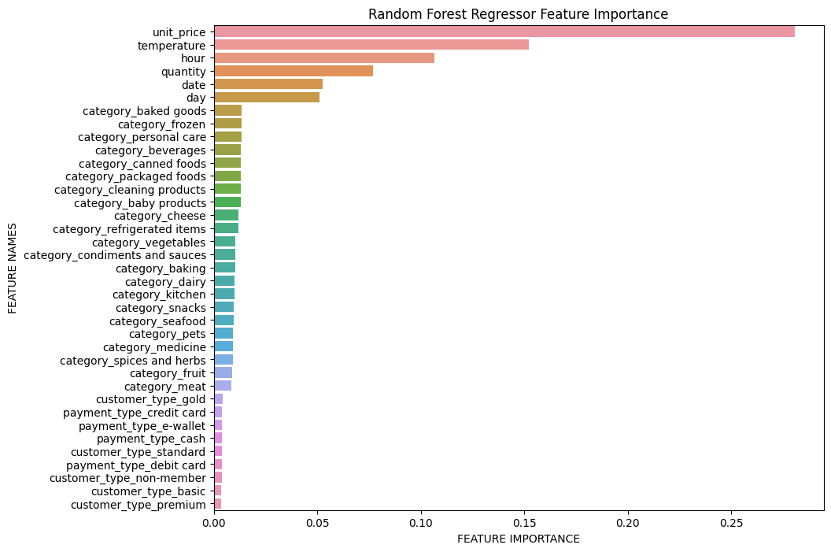
Model Training & Interpretation Results
The important features to predict the stock levels are: unit_price, temperature, hour, quantity, date, day.
Other features like category, customer_type and payment_type are not that important to predict stock levels.
Random Forest Regressor turned out to be the best model among the ML models that we used to train data.
With Random Forest Regressor: mean_squared_error = 0.0023 (train data) & mean_squared_error = 0.0069 (test data)

Slide 3
